Slide 1
welcome to
COMP 2691
Intermediate Windows Application Development in .NET
Class 9
XML Processing with .NET
Amir Ahani, M.Sc. + MBA
Microsoft Certified Solution Developer (MCSD .NET)
Microsoft Certified Database Administrator (MCDBA)
Email: amirahani@gmail.com
<number> of 44
Notes:
COMP2690 Windows Application Development with C#

Slide 2
Today…
XML in the .NET Framework
  Xml namespace
  XmlReader and XmlWriter
  The Xml Document Object Model
  XmlDocument and XmlDataDocument
  XPathDocument
  XmlConvert
  XPathNavigator
  XmlNodeReader
  XmlTextReader and XmlTextWriter
  XmlTransform
Lab: Creating a New XMLDocument from Scratch
Lab: Parsing XMLDocument Using the DOM
Lab: Parsing XMLDocument Using the XPathNavigator
<number> of 44
Notes:
COMP2690 Windows Application Development with C#

Slide 3
Today…
Lab: Searching the XmlDocument Using the DOM
Lab: Searching the XmlDocument Using the DOM
(SelectSingleNode)
Lab: Searching the XmlDocument Using the DOM
(GetElementByTagName)
Lab: Searching the XmlDocument Using the DOM
(SelectNodes)
<number> of 44
Notes:
COMP2690 Windows Application Development with C#

Slide 4
XML in the .NET Framework
  XML is a natural element of all forms of programming life, just as water, sun, and minerals are fundamental resources fro every human being. The Microsoft .NET Framework provides a comprehensive set of classes that let you work with XML documents and related technologies at various levels and in strict accordance with the most recent World Wide Web Consortium (W3C) standards and recommendations.
  The XML support available in .NET Framework covers XML 1.0, XML namespaces, Document Object Model (DOM) Level 2 Core, XML Schema Definition (XSD) Language, Extensible Stylesheet Language Transformations (XSLT), and Xpath expressions. In addition, XML core classes are tightly integrated with other key portions of the .NET Framework, including data access, serialization, and application configuration.
<number> of 44
Notes:
COMP2690 Windows Application Development with C#

Slide 5
W3C Standards Supported in the .NET Framework
  W3C Standards
Standard | Reference
XML 1.0 | http://www.w3.org/TR/1998/REC-xml-19980210
XML namespaces | http://www.w3.org/TR/REC-xml-names
XML Schema | http://www.w3.org/TR/xmlschema-2
DOM Level 1 and Level 2 Core | http://www.w3.org/TR/DOM/Level-Level-2
XPath | http://www.w3.org/TR/xpath
XSLT | http://www.w3.org/TR/xslt
SOAP 1.1 | http://www.w3.org/TR/SOAP
<number> of 44
Notes:
COMP2690 Windows Application Development with C#

Slide 6
Areas of the .NET Framework in which XML is Key
Category | Description
ADO .NET | Data container objects (for example, the dataset object) are always transferred and remoted via XML.
Configuration | Application settings are stored in XML files., making use of predefined and user-defined section readers.
Remoting | Remote .NET Framework objects can be accessed by using SOAP packets to prepare and perform the call.
Web Services | SOAP is a lightweight XML protocol that web services use for the exchange of information in a decentralized, distributed environment. Typically, you use SOAP to invoke methods on a Web Service in a platform-independent fashion.
XML parsing | The core classes providing for XML parsing and manipulating through both the stream-based API and the XML Document Object Model (XMLDOM).
XML serialization | Supplies the ability to save and restore living instances of objects to and from XML documents.
<number> of 44
Notes:
COMP2690 Windows Application Development with C#

Slide 7
Xml namespace
Class Name | Description
XmlReader | An abstract reader class that provides fast, non-cached XML data. XmlReader is forward only, like the SAX parser
XmlWriter | An abstract writer class that provides fast, non-cached XML data in stream or file format
XmlTextReader | Extends XmlReader. Provides fast forward-only stream access to XML data
XmlTextWriter | Extends XmlWriter. Fast forward-only generation of XML streams
<number> of 44

Slide 8
Practical Points
Specialized Reader Classes
XmlReader is an abstract class, it will use as a reference type when type casting is needed.
XmlTextReader: Extremely fast; the reader ensures that the XML source is well-formed but neither validates it against a schema or a DTD nor resolves any embedded entity.
XMlValidatingReader: An XML reader that can validate the source imports a DTD, an XML-Data Reduced (XDR) schema, and an XML schema definition (XSD).
XMLNodeReader: The reader specializes in parsing XML data from an XML document object model (XML DOM) subtree and does not support validation.
<number> of 44

Slide 9
Practical Points
1) Reader’s Depth Property
The depth property is used to get the nesting level of the current node and arranges a prefix string made of as many tab characters as the depth level.
2) Round-Tripping Non-XML Strings
When names contain characters that are invalid in XML names, the methods EncodeName and DecodeName can adjust them to fit into an XML name schema.
(http://www.w3.org/TR/2000/REC-xml-20001006.html)
For instance: The word space must be replaced with its hexadecimal encoded.
string xmlName=XmlConvert.EncodeName(“Order Details”);
string Name=XmlConvert.DecodeName(“Order_0x0020_Details”);
<number> of 44

Slide 10
Practical Points
Attribute Normalization
The normalization process can be summarized in a few basic rules:
  Any referenced character (&nbsp;) is expanded.
  Any white space character (blanks, carriage returns &#x0D or &#13,
  linefeeds &#x0A or &#10, and tabs &#x09 or &#9) is replaced with a
  blank (ASCII 0x20) character.
  Any leading or trailing sequence of blanks is discarded.
  Any other sequence of blanks is replaced with a single blank character
  (ASCII 0x20).
  Reader.Normalization = true;
  <book author=“Amir&#10; Ahani”> → Amir Ahani
<number> of 44

Slide 11
Practical Points
SAX Parser vs. XML reader
Significant difference exist between .NET XML readers- a kind of
cursor-like parser– and Simple API for XML (SAX) parsers.
SAX ← Push model
Readers ← Pull model
A SAX parser takes full control over the parsing process
The main advantage of SAX over XMLDOM– that is, the ability to
visit XML data in a fast, forward-only, read-only way– is still the key
feature of .NET XML readers.
<number> of 44

Slide 12
System.Xml namespace
Class Name | Description
XmlNode | An abstract class that represents a single node in an XML document. Base class for several classes in the XML namespace.
XmlDocument | Extends XmlNode. This is the W3C DOM implementation. It provides a tree representation in memory of an XML document, enabling navigation and editing.
XmlResolver | An abstract class that resolves external XML-based resources such as DTD and schema references. Also used to process <xsl:include> and <xsl:import>
XmlUrlResolver | Extends XmlResolver. Resolves external resources named by a URI
<number> of 44

Slide 13
XmlReader and XmlWriter
XmlReader
XmlTextReader
XmlNodeReader
XmlValidatingReader
XmlWriter
XmlTextWriter
<number> of 44

Slide 14
The XML Document Object Model
The XML Document Object Model (DOM)
The W3C has provided standards that define the structure and provide a standard programming interface that can be used in a wide variety of environments and applications for XML documents. This is called the Document Object Model (DOM). Classes that support the DOM are typically capable of random access navigation and modification of the XML document.
<number> of 44

Slide 15
The XML Document Object Model
XML Namespace
The XML classes are accessible by setting a reference to the System.Xml.dll file and adding the Imports System.Xml (C# using System.Xml;) directive to the code. The System.Data.dll file also extends the System.Xml namespace. This is the location of the XmlDataDocument class. If this class is required, a reference must be set to the System.Data.dll file.
<number> of 44

Slide 16
The XML Document Object Model
XML Objects
This section covers the primary XML classes in the .NET Framework. Each of these classes offers varying degrees of functionality. It’s important to look at each of the classes in detail in order to make the correct decision on which classes should be used. The following figure shows a high-level view of the objects that are covered.
<number> of 44

Slide 17
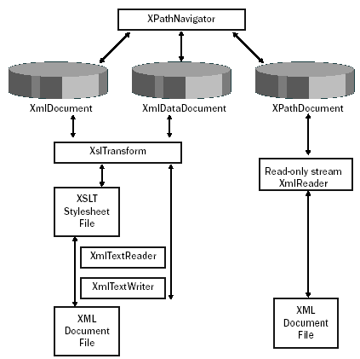
The XML Document Object Model
<number> of 44

Slide 18
XML Document Object Model
  XmlDocument and XmlDataDocument
  The XmlDocument and XmlDataDocument objects are in-memory
  representations of XML that use the Document Object Model. These
  classes can be used to navigate and edit the XML nodes.
  The XmlDataDocument inherits from the XmlDocument and also
  represents relational data. The XmlDataDocument can expose
  its data as a DataSet to provide relational and nonrelational
  views of the data. The XmlDataDocument is in the System.Data.dll
  assembly.
  These classes provide many methods, and also contain
  methods to facilitate common operations.
<number> of 44

Slide 19
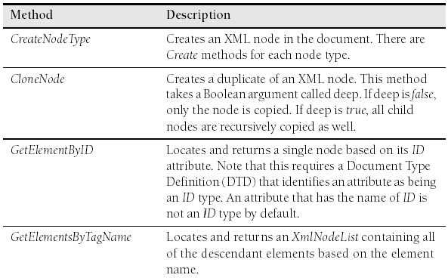
XML Document Object Model
  XmlDocument and XmlDataDocument Methods
<number> of 44

Slide 20
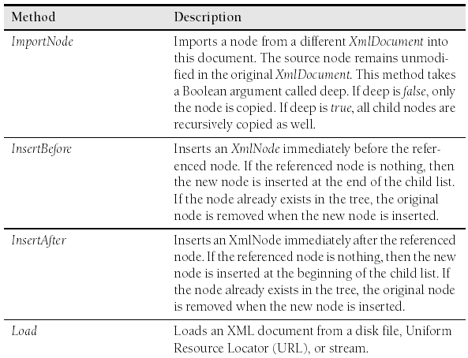
XML Document Object Model
  XmlDocument and XmlDataDocument Methods
<number> of 44

Slide 21
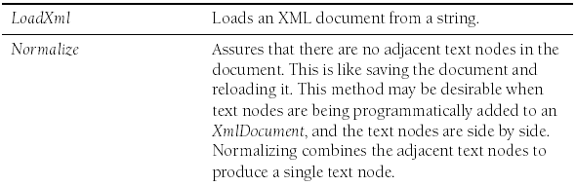
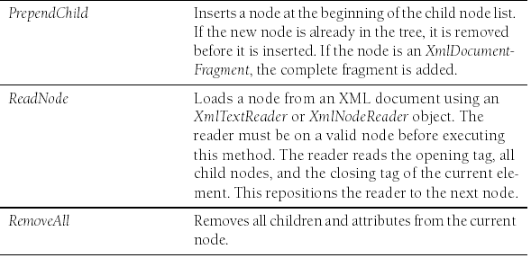
XML Document Object Model
  XmlDocument and XmlDataDocument Methods
<number> of 44

Slide 22
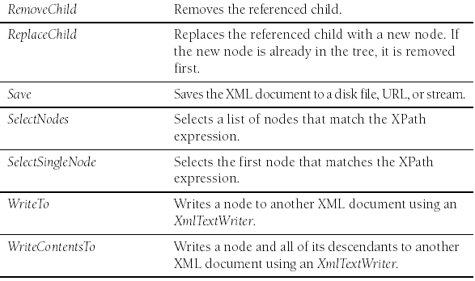
XML Document Object Model
  XmlDocument and XmlDataDocument Methods
<number> of 44

Slide 23
XML Document Object Model
  XPathDocument
  The XPathDocument provides a cached read-only XmlDocument that can be used for performing quick Xpath queries. This constructor for this class requires a stream object in order to create an instance of this object. The only useful method that this class exposes is the CreateNavigator method.
  XmlConvert
  The XmlConvert class has many static methods for converting between XSD data types and common language runtime (CLR) data types. This class is especially important when working with data sources that allow names that are not valid XML names. If a column in a database table is called List Price, trying to create an element or attribute with a space character throws an exception. Using XmlConvert to encode the name converts the space to _0x0020_, so the XML element name becomes List_x0020_Price.
<number> of 44

Slide 24
XML Document Object Model
  XPathNavigator
  The DocumentNavigator provides efficient navigation of an XmlDocument by providing XPath support for navigation. The XPathNavigator uses a cursor model and XPath queries to provide read-only random access to the data. The XPath-Navigator supports XML Stylesheet Language Transforms (XSLT) and can be used as the input to a transform.
  XmlNodeReader
  The XmlNodeReader provides forward-only access to data in an Xml-Document or XmlDataDocument. It provides the ability to start at a given node in the XmlDocument and sequentially read each node.
<number> of 44

Slide 25
XML Document Object Model
  XmlTextReader
  The XmlTextWrite provides non-cached, forward-only access to XML data. It parses XML tokens but makes no attempt to represent the XML document as a Document Object Model (DOM). The XmlTextReader does not perform document validation, but it checks the XML data to ensure that it is well formed.
  XmlTextWriter
  The XmlTextWriter provides non-cached, forward-only writing of XML data to a stream of files, ensuring that the data conforms to the W3C XML 1.0 standard. The XmlTextWriter contains logic for working with namespaces and resolving namespace conflicts.
<number> of 44

Slide 26
XML Document Object Model
  XmlReader
  The XmlReader provides an object for reading and validating against DTD, XML Schema Reduced (XDR), or Xml Schema Definition (XSD). The constructor expects a Reader or a string as the source of the XML to be validated.
  XslTransform
  The XslTransform can transform an XML document using an XSL stylesheet. The XslTransform supports XSLT 1.0 syntax and provides two methods: Load and Transform.
  The Load method is used to load an XSLT stylesheet from a file
  or a stream. The Transform method is used to perform the transformation. The Transform method has several overloads
  but essentially expects a XmlDocument or XmlNode as the first
  argument, an XsltArgumentList, and an output stream.
<number> of 44

Slide 27
XML Document Object Model
  Creating a New XmlDocument from Scratch
  To create a new XmlDocument, start by creating an XmlDocument object. The XmlDocument object contains CreateElement and CreateAttribute methods that are used to add nodes to the XmlDocument object. The XmlElement contains the Attributes property, which is an XmlAttribute-Collection. The XmlAttributeCollection inherits from the XmlNamedNodeMap class, which is a collection of names with corresponding values.
<number> of 44

Slide 28
Lab: Creating a New XMLDocument from Scratch
  protected void Button1_Click(object sender, EventArgs e)
  {
  //Declare and create new XmlDocument
  XmlDocument xmlDoc = new XmlDocument();
  XmlElement el;
  int childCounter;
  int grandChildCounter;
  //Create the xml declaration first
  xmlDoc.AppendChild( xmlDoc.CreateXmlDeclaration("1.0", "utf-8", null));
  //Create the root node and append into doc
  el = xmlDoc.CreateElement("myRoot");
  xmlDoc.AppendChild(el);
<number> of 44

Slide 29
  //Child Loop
  for (childCounter = 1; childCounter <= 4; childCounter++)
  {
  XmlElement childelmt;
  XmlAttribute childattr;
  //Create child with ID attribute
  childelmt = xmlDoc.CreateElement("myChild");
  childattr = xmlDoc.CreateAttribute("ID");
  childattr.Value = childCounter.ToString();
  childelmt.Attributes.Append(childattr);
  //Append element into the root element
  el.AppendChild(childelmt);
  for (grandChildCounter = 1; grandChildCounter <= 3; grandChildCounter++)
  {
  //Create grandchildren
  childelmt.AppendChild(xmlDoc.CreateElement("GrandChild"));
  }
  }
  //Save to file
  xmlDoc.Save( "XmlDocumentTest.xml");
  label1.Text = "XmlDocumentTest.xml Created";
  }
<number> of 44

Slide 30
Practical Point
  This code started by creating an instance of an XmlDocument. Next, the XML declaration is created and placed inside the child collection. An exception is thrown if this is not the first child of the XmlDocument.
<number> of 44

Slide 31
Lab: Parsing XMLDocument Using the DOM
  protected void Button2_Click(object sender, EventArgs e)
  {
  XmlDocument xmlDoc = new XmlDocument();
  xmlDoc.Load("XmlDocumentTest.xml");
  RecurseNodes(xmlDoc.DocumentElement);
  }
  public void RecurseNodes(XmlNode node)
  {
    //start recursive loop with level 0
    RecurseNodes(node, 0);
  }
<number> of 44

Slide 32
  public void RecurseNodes(XmlNode node, int level)
  {
  string s;
  s = string.Format("{0} Type:{1} Name:{2} Attr: ",
  new string('-', level), node.NodeType, node.Name);
  foreach (XmlAttribute attr in node.Attributes)
  {
  s += string.Format("{0}={1} ", attr.Name, attr.Value);
  }
  lbl.Text += s + "\n";
  foreach (XmlNode n in node.ChildNodes)
  {
  RecurseNodes(n, level + 1);
  }
  }
<number> of 44

Slide 33
Practical Point
  This code starts by loading an XML file and then calling a procedure called RecurseNodes. The RecurseNodes procedure is overloaded. The first call simply passes the xmlDoc’s root node. The recursive calls pass the recursion level. Each time the RecurseNodes procedure executes, the node information is printed, and for each child that the node has, a recursive call is made.
<number> of 44

Slide 34
Lab: Parsing XMLDocument Using the XPathNavigator
  protected void Button3_Click(object sender, EventArgs e)
  {
  XmlDocument xmlDoc = new XmlDocument();
  xmlDoc.Load("XmlDocumentTest.xml");
  XPathNavigator xpathNav = xmlDoc.CreateNavigator();
  xpathNav.MoveToRoot();
  RecurseNavNodes(xpathNav);
  }
  public void RecurseNavNodes(XPathNavigator node)
  {
  //start recursive loop with level 0
  RecurseNavNodes(node, 0);
  }
<number> of 44

Slide 35
  public void RecurseNavNodes(XPathNavigator node, int level)
  {
  string s = null;
  s = string.Format("{0} Type:{1} Name:{2} Attr: ",
  new string('-', level), node.NodeType, node.Name);
  if (node.HasAttributes)
  {
  node.MoveToFirstAttribute();
  do
  {
  s += string.Format("{0}={1} ", node.Name, node.Value);
  } while (node.MoveToNextAttribute());
  node.MoveToParent();
  }
  lbl.Text += s + "\n";
  if (node.HasChildren)
  {
  node.MoveToFirstChild();
  do
  {
  RecurseNavNodes(node, level + 1);
  } while (node.MoveToNext());
  node.MoveToParent();
  }
  }
<number> of 44

Slide 36
Practical Points
  This is recursive code that works in a similar fashion to the DOM example that was previously covered. The difference is in the methods that are used to get access to each node. To get access to the attributes, there is a HasAttributes property that is true if the current node has attributes. The MoveToFirstAttribute and MoveToNextAttribute methods are used to navigate the attributes. After the attribute list has been navigated, the MoveToParent method moves back to the element.
  The HasChildren property returns true if the current node has child nodes. The MoveToFirstChild and MoveToNext are used to navigate the child nodes. After the children have been navigated, the MoveToParent method moves back to the parent element.
  Depending on the task at hand, it may be more preferable to use the XPathNavigator instead of the DOM. In this lab, other than syntax, there is little difference between the two methods.
<number> of 44

Slide 37
XML Document Object Model
  Searching the XmlDocument Using the DOM
  The DOM provides GetElementByID and the GetElementsByTagName methods for searching an XmlDocument. The GetElementByID method locates an element based on its ID. The ID refers to an ID type that has been defined in a DTD document.
<number> of 44

Slide 38
Lab: Searching the XmlDocument Using the DOM
  protected void Button4_Click(object sender, EventArgs e)
  {
  string s;
  //Declare and create new XmlDocument
  XmlDocument xmlDoc = new XmlDocument();
  xmlDoc.Load("XmlSample.xml");
  XmlNode node;
  node = xmlDoc.GetElementById("ref-3");
  s = string.Format("Type:{0} Name:{1} Attr:",
  node.NodeType, node.Name);
  foreach (XmlAttribute a in node.Attributes)
  {
  s += string.Format("{0}={1} ", a.Name, a.Value);
  }
  label1.Text = s + "\n";
  }
<number> of 44

Slide 39
XML File – XmlSample.xml
<?xml version="1.0" encoding="utf-8"?>
<!DOCTYPE myRoot [
<!ELEMENT myRoot ANY>
<!ELEMENT myChild ANY>
<!ELEMENT myGrandChild EMPTY>
<!ATTLIST myChild ChildID ID #REQUIRED > ]>
<myRoot>
<myChild ChildID="ref-1">
<myGrandChild/>
<myGrandChild/>
<myGrandChild/>
</myChild>
<myChild ChildID="ref-2">
<myGrandChild/>
<myGrandChild/>
<myGrandChild/>
</myChild>
<myChild ChildID="ref-3">
<myGrandChild/>
<myGrandChild/>
<myGrandChild/>
</myChild>
<myChild ChildID="ref-4">
<myGrandChild/>
<myGrandChild/>
<myGrandChild/>
</myChild>
</myRoot>
<number> of 44

Slide 40
Practical Points
  The SelectSingleNode method can also be used to locate an element. The SelectSingle-Node method requires an XPath query to be passed into the method. The previous code sample has been modified to call the SelectSingleNode method to achieve the same result using an XPath query.
<number> of 44

Slide 41
Lab: Searching the XmlDocument Using the DOM (SelectSingleNode)
  protected void Button5_Click(object sender, EventArgs e)
  {
  string s;
  //Declare and create new XmlDocument
  XmlDocument xmlDoc = new XmlDocument();
  xmlDoc.Load("XmlSample.xml");
  XmlNode node;
  node = xmlDoc.SelectSingleNode("//myChild[@ChildID='ref-3']");
  s = string.Format("Type:{0} Name:{1} Attr:", node.NodeType, node.Name);
  foreach (XmlAttribute a in node.Attributes)
  {
  s += string.Format("{0}={1} ", a.Name, a.Value); }
  lbl.Text = s + "\n";
  }
<number> of 44

Slide 42
Lab: Searching the XmlDocument Using the DOM (GetElementByTagName)
  protected void Button6_Click(object sender, EventArgs e)
  {
  string s;
  //Declare and create new XmlDocument
  XmlDocument xmlDoc = new XmlDocument();
  xmlDoc.Load("XmlSample.xml");
  XmlNodeList elmts;
  elmts = xmlDoc.GetElementsByTagName("myGrandChild");
  foreach (XmlNode node in elmts)
  {
  s = string.Format("Type:{0} Name:{1}",
  node.NodeType, node.Name);
  lbl.Text += s + "\n";
  }
  }
<number> of 44

Slide 43
Lab: Searching the XmlDocument Using the DOM (SelectNodes)
  protected void Button7_Click(object sender, EventArgs e)
  {
  string s;
  //Declare and create new XmlDocument
  XmlDocument xmlDoc = new XmlDocument();
  xmlDoc.Load("XmlSample.xml“);
  XmlNodeList elmts;
  elmts = xmlDoc.SelectNodes("//myGrandChild");
  foreach (XmlNode node in elmts)
  {
  s = string.Format("Type:{0} Name:{1}",
  node.NodeType, node.Name);
  lbl.Text += s + "\n";
  }
  }
<number> of 44

Slide 44
Practical Point
  Using the XPathNavigator to Search XPathDocuments
  The XPathNavigator offers much more flexibility for performing searches than what is available through the DOM. The XPathNavigator has many methods that are focused around XPath queries using a cursor model. The XPathNavigator works with the XmlDocument, but the XPathDocument object is tuned for the XPathNavigator and uses fewer resources than the XmlDocument. If the DOM is not required, use the XPathDocument instead of the XmlDocument.
<number> of 44

